Slide 1

The Mass Spectrometer
A VERY useful machine for measuring the masses of atoms (ions) and their relative abundances.
Lets get this presentation started!
ENGAGE!

Slide 2
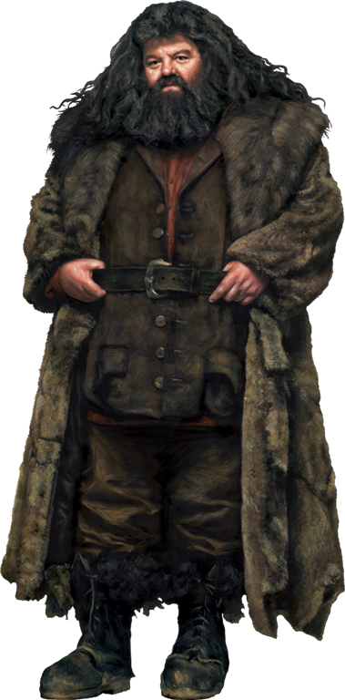

The Mass Spectrometer
Don' you worry, Harry. You'll learn fast enough. Everyone starts at the beginning in Physics
velocity selector
Region of magnetic field
ions produced
ions accelerated
ion beam
This looks difficult Hagrid!
detector

Slide 3

The Mass Spectrometer
Substance to be tested is turned into a gas by heating.
Very Nice!
Electrons are produced at a hot cathode and accelerated by an electric field. Collision with gas particles produces ions.

Slide 4

The Mass Spectrometer
Ions acclerated by an electric field

Slide 5

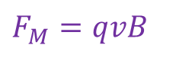
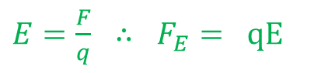
The Mass Spectrometer
$E=\frac{F}{q} ∴ F_{E}= qE$
$F_{M}=qvB$
This is relatively easy!
Ions enter the velocity selector which contains an electric field (up the page) and magnetic field (into the page) at right angles to each other.
By choosing a suitable value for the magnetic field the ions continue in a straight line.
i.e. The force produced by the electric field (qE) is equal to the force produced by the magnetic field (qvB). qE = qvB

Slide 6
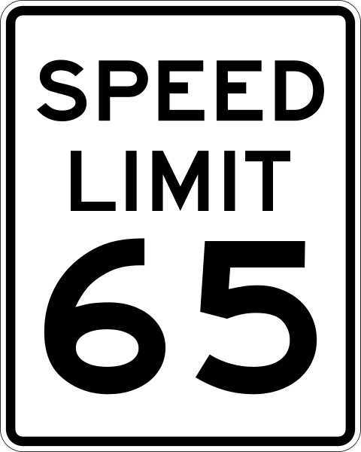
The Mass Spectrometer
qE = qvB
or v = E/B
This means that only ions with a specific velocity pass through this region. (Hence ”velocity selector”)

Slide 7


The Mass Spectrometer
The selected ions all with the same velocity (but different masses of course) enter the second region of magnetic field (also into the page). They are deflected in a circular path.

Slide 8
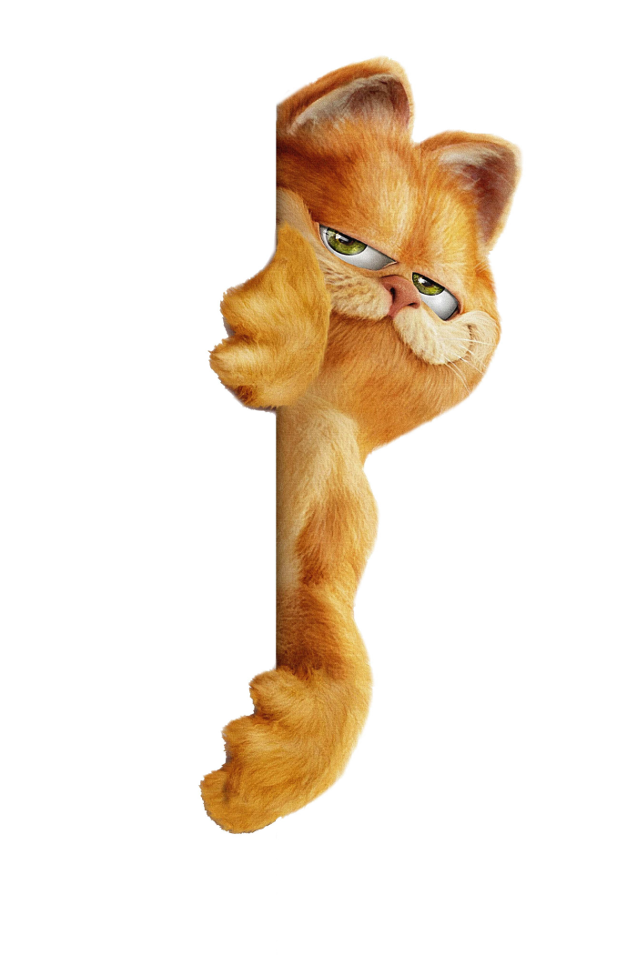
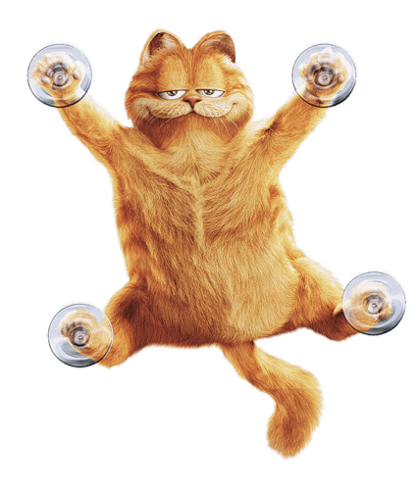
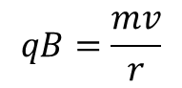
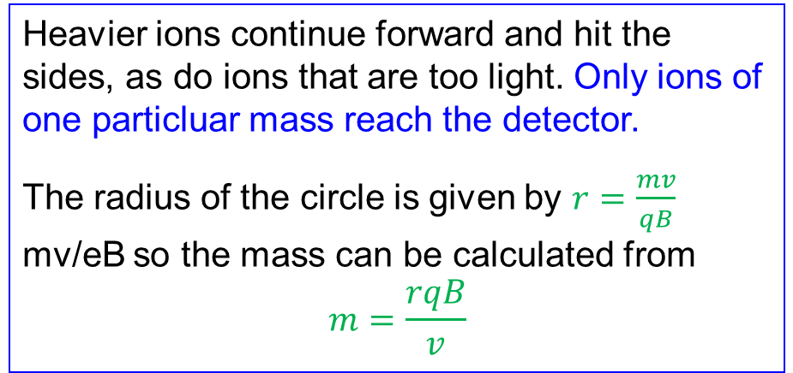
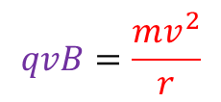

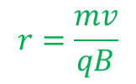
The Mass Spectrometer
$$F_{M}=F_{C}$$
$$qvB=\frac{mv^{2}}{r}$$
$$qB=\frac{mv}{r}$$
$$r=\frac{mv}{qB}$$
You cant make me hit the side!!
Heavier ions continue forward and hit the sides, as do ions that are too light. Only ions of one particluar mass reach the detector.
The radius of the circle is given by $r=\frac{mv}{qB}$ mv/eB so the mass can be calculated from
$$m=\frac{rqB}{v}$$

Slide 9
The Mass Spectrometer
The magnetic field can be varied so that ions of different mass can be detected (higher B would mean that ions of larger mass could be directed at the detector).

Slide 10
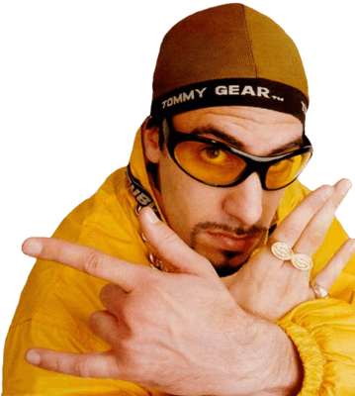
The Mass Spectrometer
Respek!
The detector can measure the numbers of ions detected, hence giving an idea of relative abundance of different ions.

Slide 11

The Mass Spectrometer
My wall will keep the illegal ions out!!
The mass spectrometer is particulary useful for identifying isotopes of the same element.

